Slide 1
CMSC 426 Principles of Computer Security
Offensive Security and Hardening

Slide 2
Last Class We Covered
Hardening
Windows hardening methods
Defender
Automatic updates
Security policy
Group policy

Slide 3
Any Questions from Last Time?

Slide 4
Today’s Topics
Offensive security
What it is
Attacker Lifecycle
Common tools
Demo
Effective Windows Hardening

Slide 5
Offensive Security

Slide 6
What is Offensive Security?
Subset of the security field
Focuses on assessing the security of machines or networks by attempting to attack them
Goal is to be proactive rather than reactive
We’ve previously talked about figuring out who launched an attack, or tracing them back to their source
Much easier to prevent it in the first place
The best defense is a good offense!

Slide 7
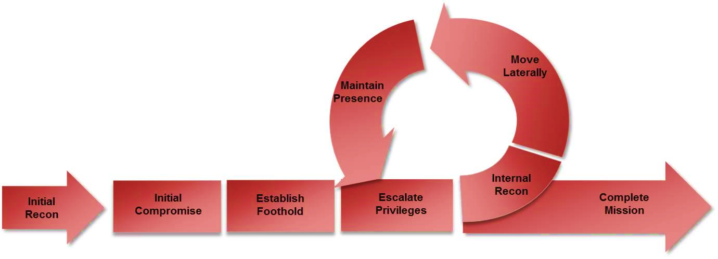
Attacker Lifecycle
Most important part – without recon (and enumeration), success is unlikely

Slide 8
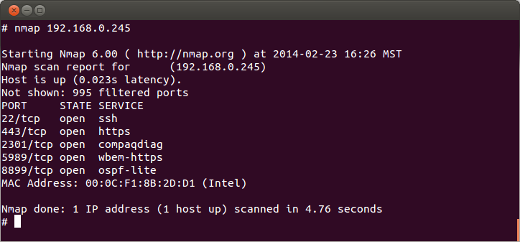
1: Reconnaissance
“Knowing your target”
Involves gathering information about the target
Can often be collected without the target detecting it
Technical information
Network information from scanning, etc.
Port scanning

Slide 9
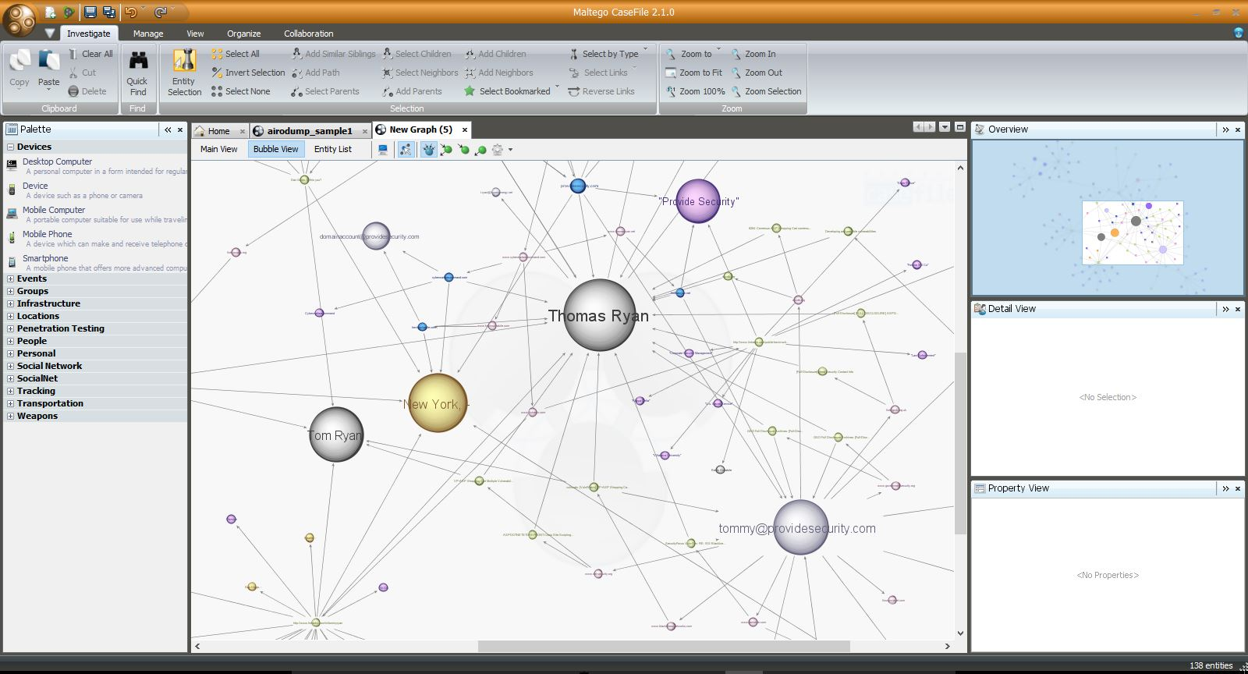
1: Reconnaissance (continued)
Business information
OSINT (Open Source INTelligence)
Going to a company’s website, github, trello board, etc.
Information about employees, positions, technology they use
Real examples: passwords in code comments, keys committed to github
Goal is to get information you can use to get in

Slide 10
1.5: Enumeration
Goal in this stage is to identify exactly what versions of which services are running
Look for known exploits and vulnerabilities for those specific versions
Are there common misconfigurations which show up a lot with these specific technologies?
How do you test for these misconfigurations?

Slide 11
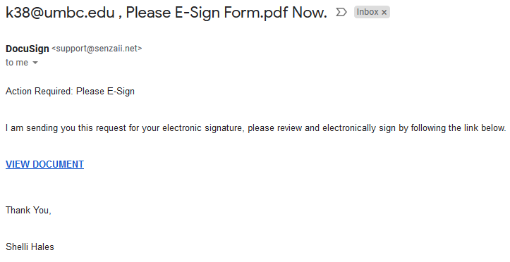
2: Compromise
Actually breaking into machines, often what people think about when they think of “hacking”
Not actually that exciting though
It only takes one weak link to own an enterprise
Phishing emails, infected document downloads
Why client-side exploits are still a thing

Slide 12
3: Persistence
After you initially gain access into a network, you want to make sure you can always get back in
This doesn’t just mean in 5 minutes, it means days, weeks, or months later
Ideally even after reboots, resets, etc.

Slide 13
3: Post Exploitation
This is what separates the skilled attackers from everyone else
What can you do with your access?
Can you escalate privileges on your local machine?
What is accessible within the network?
Can you get access to file servers, internal source code, documents?
Can you get access to other users’ machines?
Can you elevate your privileges on a network level?
To Domain Administrator?
How easy is it to stay undetected?

Slide 14
Tools and Attacks

Slide 15
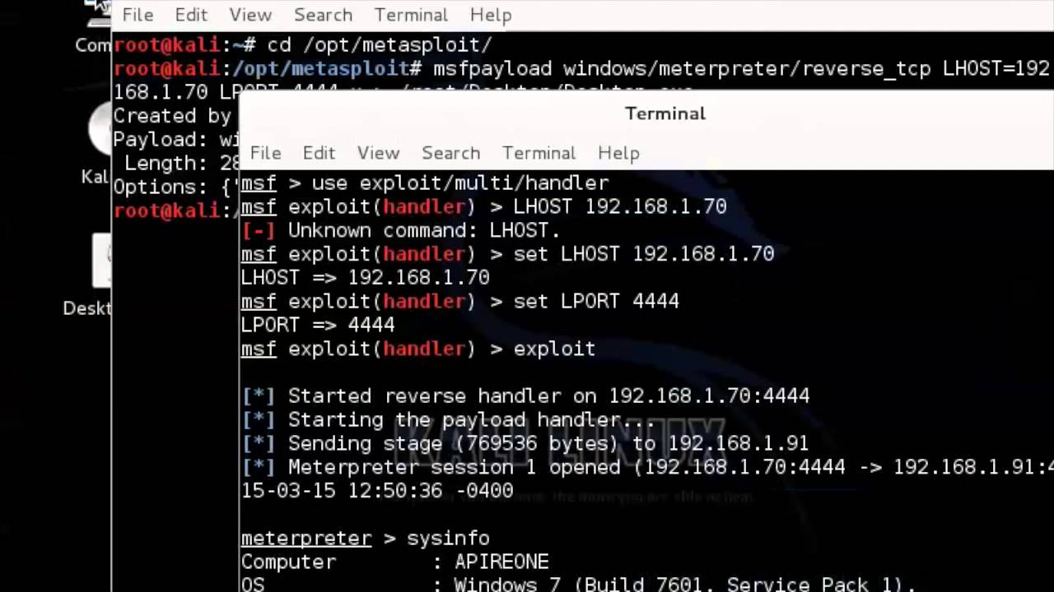
Metasploit
Open source attack framework, written in Ruby
Can be used to write and launch own exploits
Managing different sessions
Escalating privileges
Covers basically everything you would need
Very much a “point-and-click tool”

Slide 16
Using Metasploit
Walks you through the major steps in launching an attack
Choosing and setting up an exploit
Checking to see if the target is vulnerable
Choosing and configuring a payload
Choosing the encoding and evasion techniques for the payload
Launching the attack
Handling the connections
This one is particularly useful

Slide 17
Recap: LSA and LSASS
LSA (Local Security Authority)
Windows subsystem responsible for managing authentication and local security policy
LSASS (LSA Subsystem Service)
The process in which LSA runs
Responsible for providing single sign-on functionality in Windows
Does this by caching credentials in memory. Why is this bad?

Slide 18
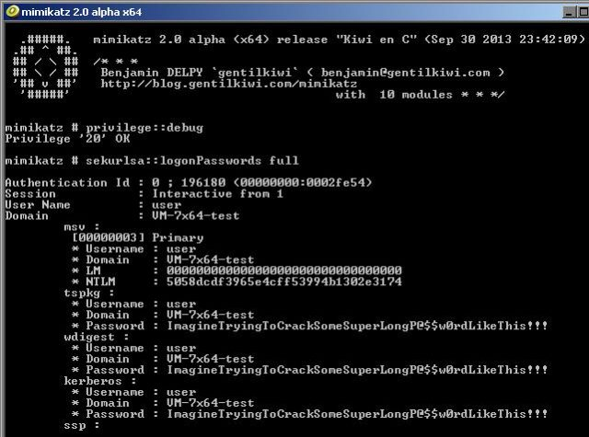
Mimikatz
Tool which can dump Windows passwords (and other things) from the memory
For every user who logged in since the last boot
(This should scare you)

Slide 19
“Passing” Attacks

Slide 20
“Passing” Attacks
Pass the Hash and Pass the Ticket
Goal of both attacks is to impersonate another user
Pass the Hash: specifically, password hashes
Pass the Ticket: Kerberos tickets
Allows attacker to
Gain access to new info and systems
Hide their tracks (and prevent discovery)

Slide 21
How a Pass the Hash Attack Works
Using a stolen password hash in place of the actual password
(e.g., obtained through Mimikatz)
Want to authenticate as a user without having access to their plaintext password(s)
Fortunately, NTLM hashes are often just as good as passwords
Lots of Windows functions will accept a hash in place of a password
Newer systems store just the hash in memory
Older systems store both the hash and the plaintext (yay?)

Slide 22
Exploiting a Pass the Hash Attack
Can now be used for lateral movement or spawning processes
Connecting to other systems using that same user account/password
Launching processes under another account name
Launching has two benefits:
The launching of the application/process cannot be easily traced back to the person who actually launched it, just the username who did so
Other users may have more privileges

Slide 23
How a Pass the Ticket Attack Works
Hacker validates themselves as a specific user by presenting a Kerberos ticket (TGT or SGT) to the system
Grab another user’s cached Kerberos ticket (still valid)
Use that ticket as your own, with that user’s privileges
Kerberos makes use of NTLM hashes on Windows machines
Why does this work? Doesn’t Kerberos verify ticket validity?
There’s a 20-minute window after creation where this doesn’t happen

Slide 24
Three Types of Tickets
Regular Ticket
Intercepted tickets meant for another user
May have higher privileges than attacker does
“Silver” Tickets (Service-Granting Ticket)
Forged ticket for specific services
Lets the attacker “write their own” ticket for that specific service
“Golden” Tickets (Ticket-Granting Ticket)
Forged ticket for essentially anything
Lets the attacker “write their own” ticket for anything

Slide 25
“Fancy” Tickets
Silver tickets
Requires the Service Account password hash
Golden tickets
Requires the KRBTGT (Kerberos TGT) password hash
Allows the attacker to sort of “impersonate” the AS
Means they can write a ticket for any service on any machine for any user
Including users that don’t exist in the system
Only way to remove a golden ticket’s effectiveness
Change password twice (keeps old password for older tickets)

Slide 26
DEMO TIME!!!

Slide 27
Windows Hardening

Slide 28
General Hardening Tips
Patch! Patch! Patch!
Remove or disable unnecessary services
Good account and password practices
Good firewall practices
Your current Windows defaults are NOT good enough

Slide 29
Mimikatz-Specific Defense
Disable cleartext passwords in memory
Apply corresponding patch and edit corresponding registry key
HKEY_LOCAL_MACHINE/SYSTEM/CurrentControlSet/Control/SecurityProviders/WDigest/UseLogonCredential
Default in Windows 8.1 and later
Good account and password practices

